Slide 1


Deep Reinforcement Learning for Traffic Light Control
AE 598 Final Project
Presented by : Manav Vora

Slide 2

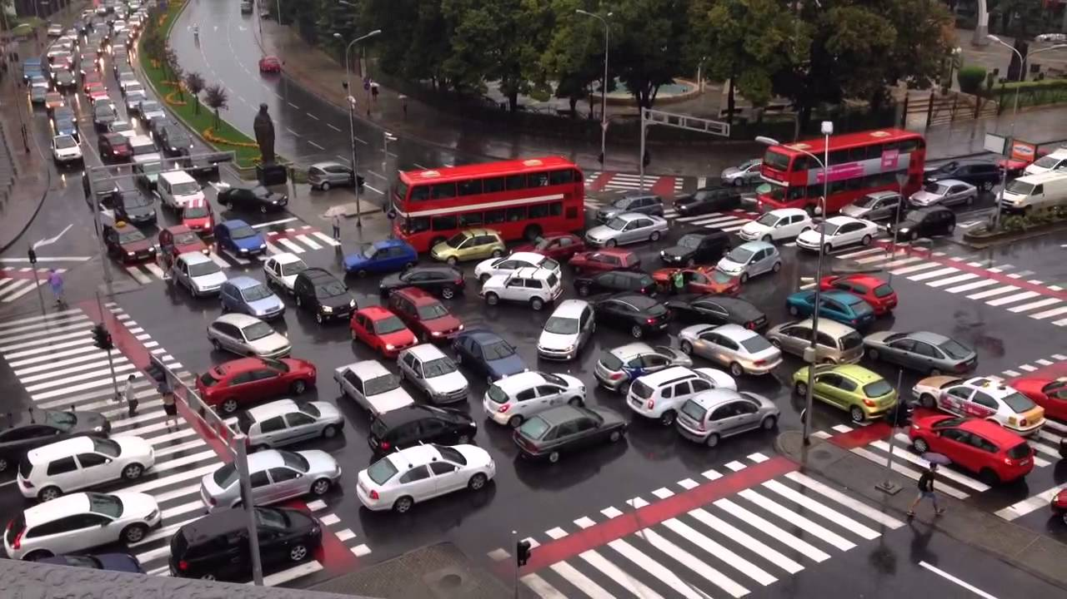
Introduction
Traffic congestion is a major problem in cities
Inefficient traffic light control causes numerous problems
Conventional traffic light control methods have low efficiency
Deep RL widely used in traffic signal control
Fig. 1 : Traffic congestion at an intersection
AE 598 Reinforcement Learning
GRAINGER ENGINEERING
Notes:
The inefficient traffic light control causes numerous problems, such as long delay of travelers, huge waste of energy and worsening air quality. In some cases, it may also contribute to vehicular accidents [1], [2].
Conventional methods include changing the traffic signal phases in a pre-determined sequence

Slide 3
Contributions
Applying two deep RL algorithms to the traffic light control problem:
DQN - Reproduced the results of Vidali, Andrea et al. “A Deep Reinforcement Learning Approach to Adaptive Traffic Lights Management.” Workshop From Objects to Agents (2019).
PPO - Comparing performance with DQN
Generating simulations using Simulation of Urban MObility - SUMO
AE 598 Reinforcement Learning
GRAINGER ENGINEERING

Slide 4
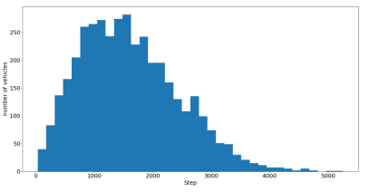
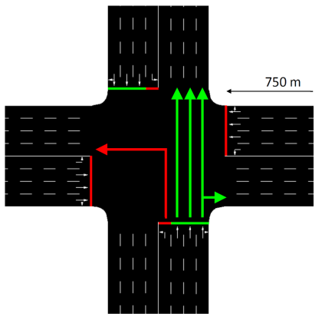
Experimental Setup
The Environment
SUMO Traffic simulator
1 second per step and 5400 steps per episode for traffic generation
Traffic generated according to a Weibull distribution
For every vehicle generated, the source and destination arms are determined using a random number generator
High Traffic Scenario:
1000 cars approach the intersection from every arm (evenly distributed)
75% go straight
25% go either left or right
Fig. 2 : Weibull Distribution for Traffic Generation
Fig. 3 : Traffic Intersection in SUMO
AE 598 Reinforcement Learning
GRAINGER ENGINEERING
Notes:
The Weibull distribution approximates specific traffic situations, where during the early stage the number of cars is rising, representing a peak hour. Then, the number of incoming cars slowly decreases describing the gradual mitigation of traffic congestion

Slide 5
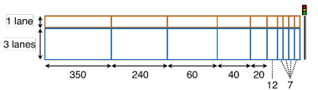
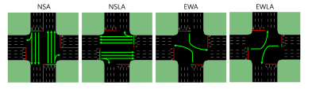
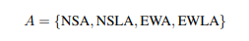
Method
MDP Model of the Environment
State Vector : Each arm of the incoming lanes is discretized into 20 cells to indicate occupancy by a vehicle. State vector is of size 80
Action Space : 4 possible actions at each time instant
Each phase has a fixed duration
Fig. 4: Discretization of an incoming lane
Fig. 5: Graphical Representation of the 4 possible actions
AE 598 Reinforcement Learning
GRAINGER ENGINEERING
Notes:
Technically, in each arm of the intersection incoming lanes are discretized in cells that can identify the presence or absence of a vehicle inside them. In Figure 5 is showed the state representation for the west arm of the intersection. Between the beginning of the road and the intersection’s stop line, there are 20 cells. 10 of them are located along the left-only lane while the others 10 cover the others three lanes. Therefore, in the whole intersection there are 80 cells. Not every cell has the same size: the further the cell is from the stop line, the longer it is, so more lane length is covered. The choice of the length of every cell is not trivial: if cells were too long, some cars approaching the crossing line may not be detected; if cells were too short, the number of states required to cover the length of the lane increases, bringing to higher computational complexity. In this paper, the length of the shortest cells, which are also the closest to the stop line, is exactly 2 meters longer than the length of a car.
• North-South Advance (NSA): the green phase is active for vehicles that are in the north and south arm and wants to proceed straight or turn right. • North-South Left Advance (NSLA): the green phase is active for vehicles that are in the north and south arm and wants to turn left. • East-West Advance (EWA): the green phase is active for vehicles that are in the east and west arm and wants to proceed straight or turn right. • East-West Left Advance (EWLA): the green phase is active for vehicles that are in the east and west arm and wants to turn left.

Slide 6
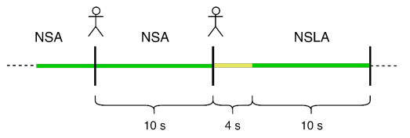
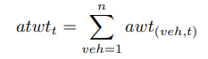
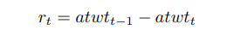
Method
MDP Model of the Environment
If the action chosen by the agent at timestep t is different from t-1, then a yellow phase is activated
Reward Model :
Fig. 6 : Possible differences between timesteps
AE 598 Reinforcement Learning
GRAINGER ENGINEERING
Notes:
Vice-versa if the action is same, there is no yellow phase
Where awt(veh,t) is the amount of time in seconds a vehicle veh has a speed of less than 0.1 m/s at agentstep t, since the spawn into the environment. n represents the total number of vehicles in the environment in agentstep t. Therefore, atwtt is the accumulated total waiting time at agentstep t. With this metric, when the vehicle departs but it does not manage to cross the intersection, the value of atwtt does not resets (unlike the value of twtt), avoiding the misleading reward associated with the literature reward function, when a long queue build up at the intersection. Once the metric is set, the alternative reward function is defined such as in equation (5)

Slide 7
Simulations
Hyperparameters Used
Parameter | Value
Episodes for Training | 150
Epsilon for episode k (DQN) | 1 - k/150
Memory size (DQN) | 50000
Batch Size (DQN) | 100
Number of Hidden Layers of Neural Network | 4
Learning Rate (DQN) | 0.001
Parameter | Value
Episodes for Training | 150
Learning Rate (Actor) | 0.001
Learning Rate (Critic) | 0.001
Policy Update Frequency | 100 steps
Number of Hidden Layers of Neural Network | 2
Epsilon Clip | 0.2
AE 598 Reinforcement Learning
GRAINGER ENGINEERING

Slide 8
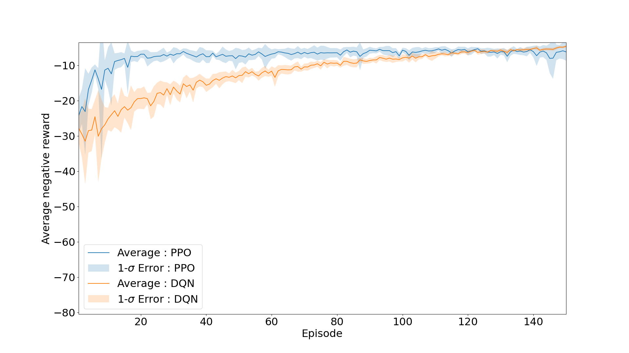
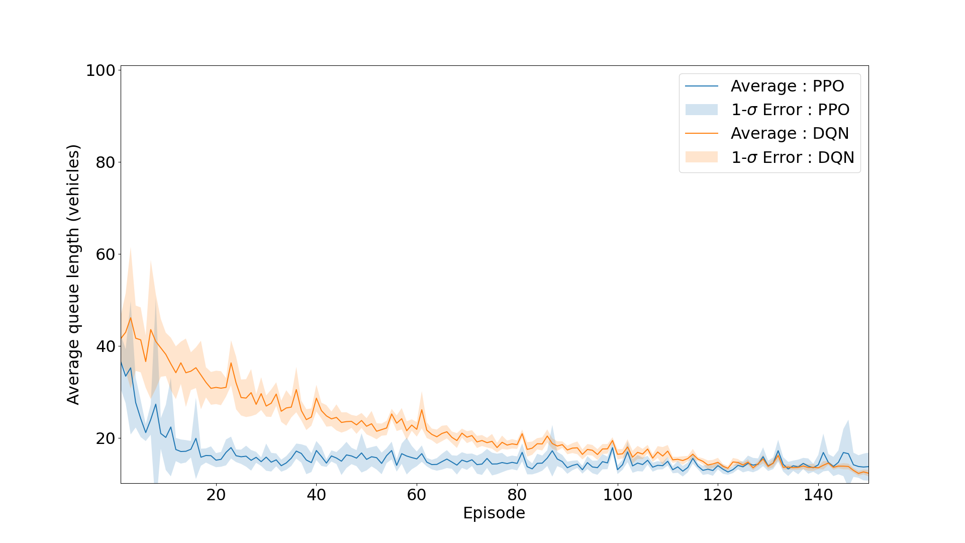
Simulations
Training Results
Fig. 7 : Average Reward for PPO and DQN
Fig. 8 : Average Queue Length for PPO and DQN
AE 598 Reinforcement Learning
GRAINGER ENGINEERING

Slide 9
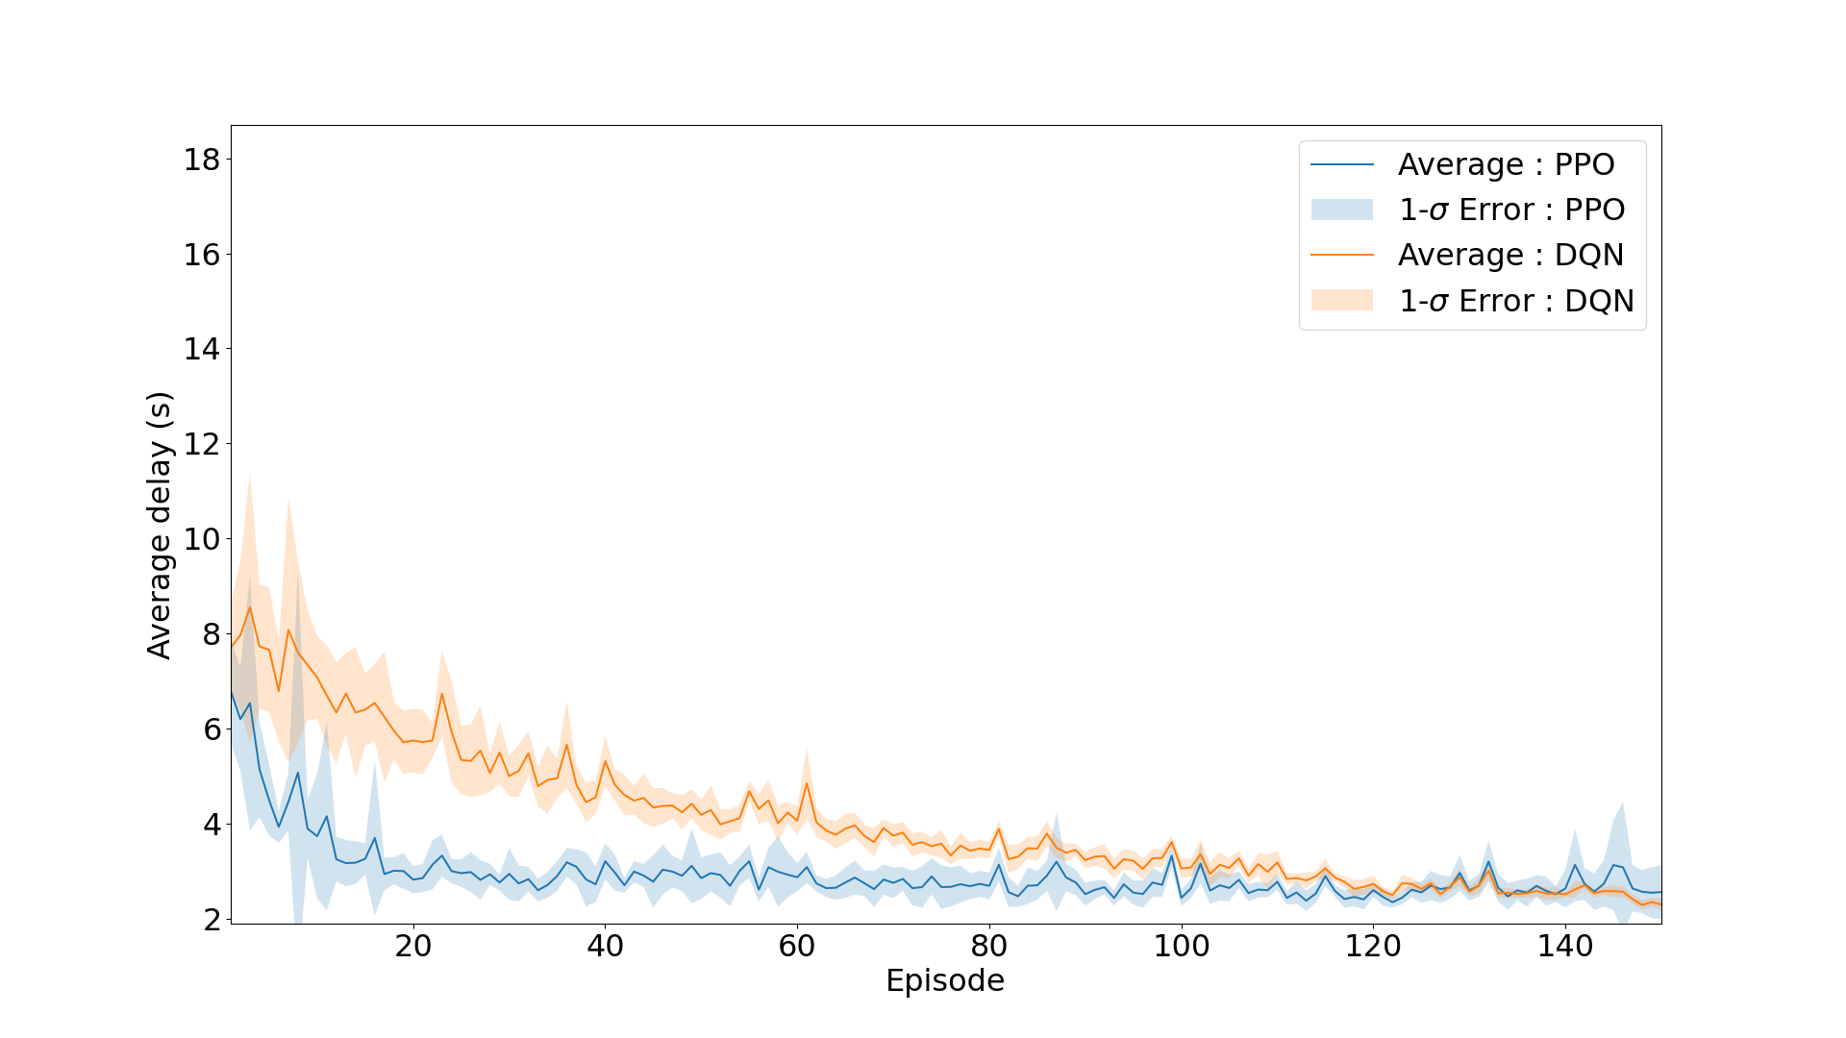
Simulations
Training Results
Fig. 9 : Average Delay for PPO and DQN
AE 598 Reinforcement Learning
GRAINGER ENGINEERING

Slide 10
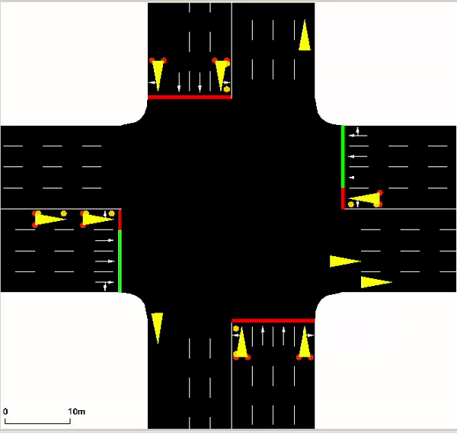
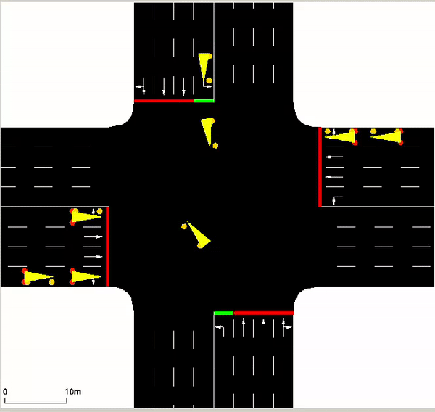
Simulations
Testing Results
Fig. 10 : PPO
Fig. 11 : DQN
AE 598 Reinforcement Learning
GRAINGER ENGINEERING

Slide 11
Conclusions and Future Work
Deep Reinforcement Learning efficiently solves the traffic signal control problem
PPO outperforms DQN as it learns the optimal strategy much faster
Convert to multi-agent problem
Control times of the different phases as well
AE 598 Reinforcement Learning
GRAINGER ENGINEERING

Slide 12
References
Vidali, Andrea et al. “A Deep Reinforcement Learning Approach to Adaptive Traffic Lights Management.” Workshop From Objects to Agents (2019).
AE 598 Reinforcement Learning
GRAINGER ENGINEERING

